Slide 1


BlackRock Investment Analysis
Weekly status report 8

Slide 2



Team Members
Aryan Radadiya
Developer
Joyson Gonsalves
Team Lead
Sumit Kumar Pandey
Data Analyst

Slide 3
Date of Report: 12th March 2024
Date of Last Report: 4th March 2024
Prepared By: Group 7
Project Status: On Track

Slide 4

Activities Since Last Report
Issues or Challenges encountered this week:
Exporting model data from Jupiter notebook.
What was done to overcome them:
We exported the data in a excel sheet and then imported it to power bi.

Slide 5
Activities Since Last Report
Task completed this week:
Started designing the visualization.
Completed the cleaning and importing the data in power bi.

Slide 6

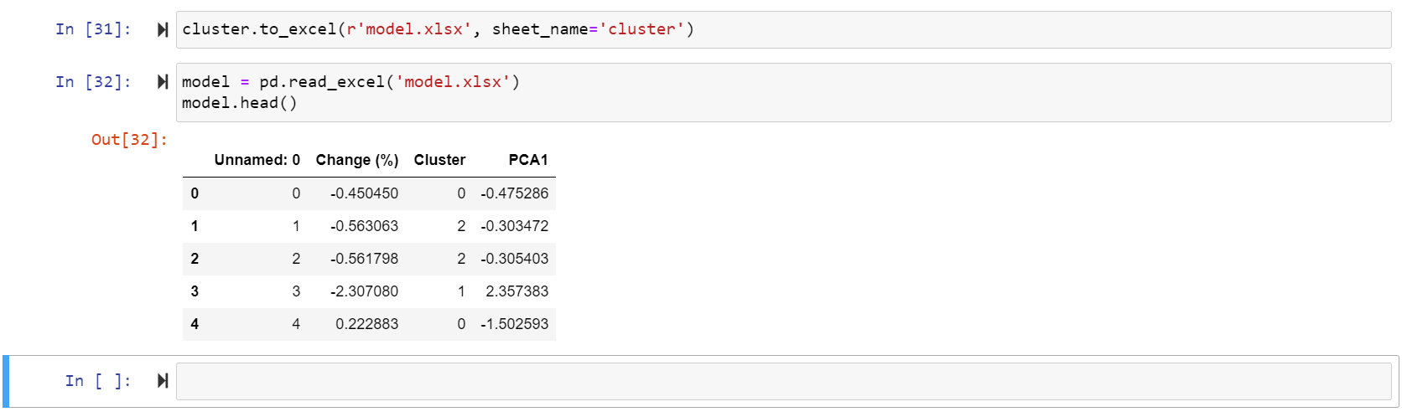
Screenshots of Activities

Slide 7
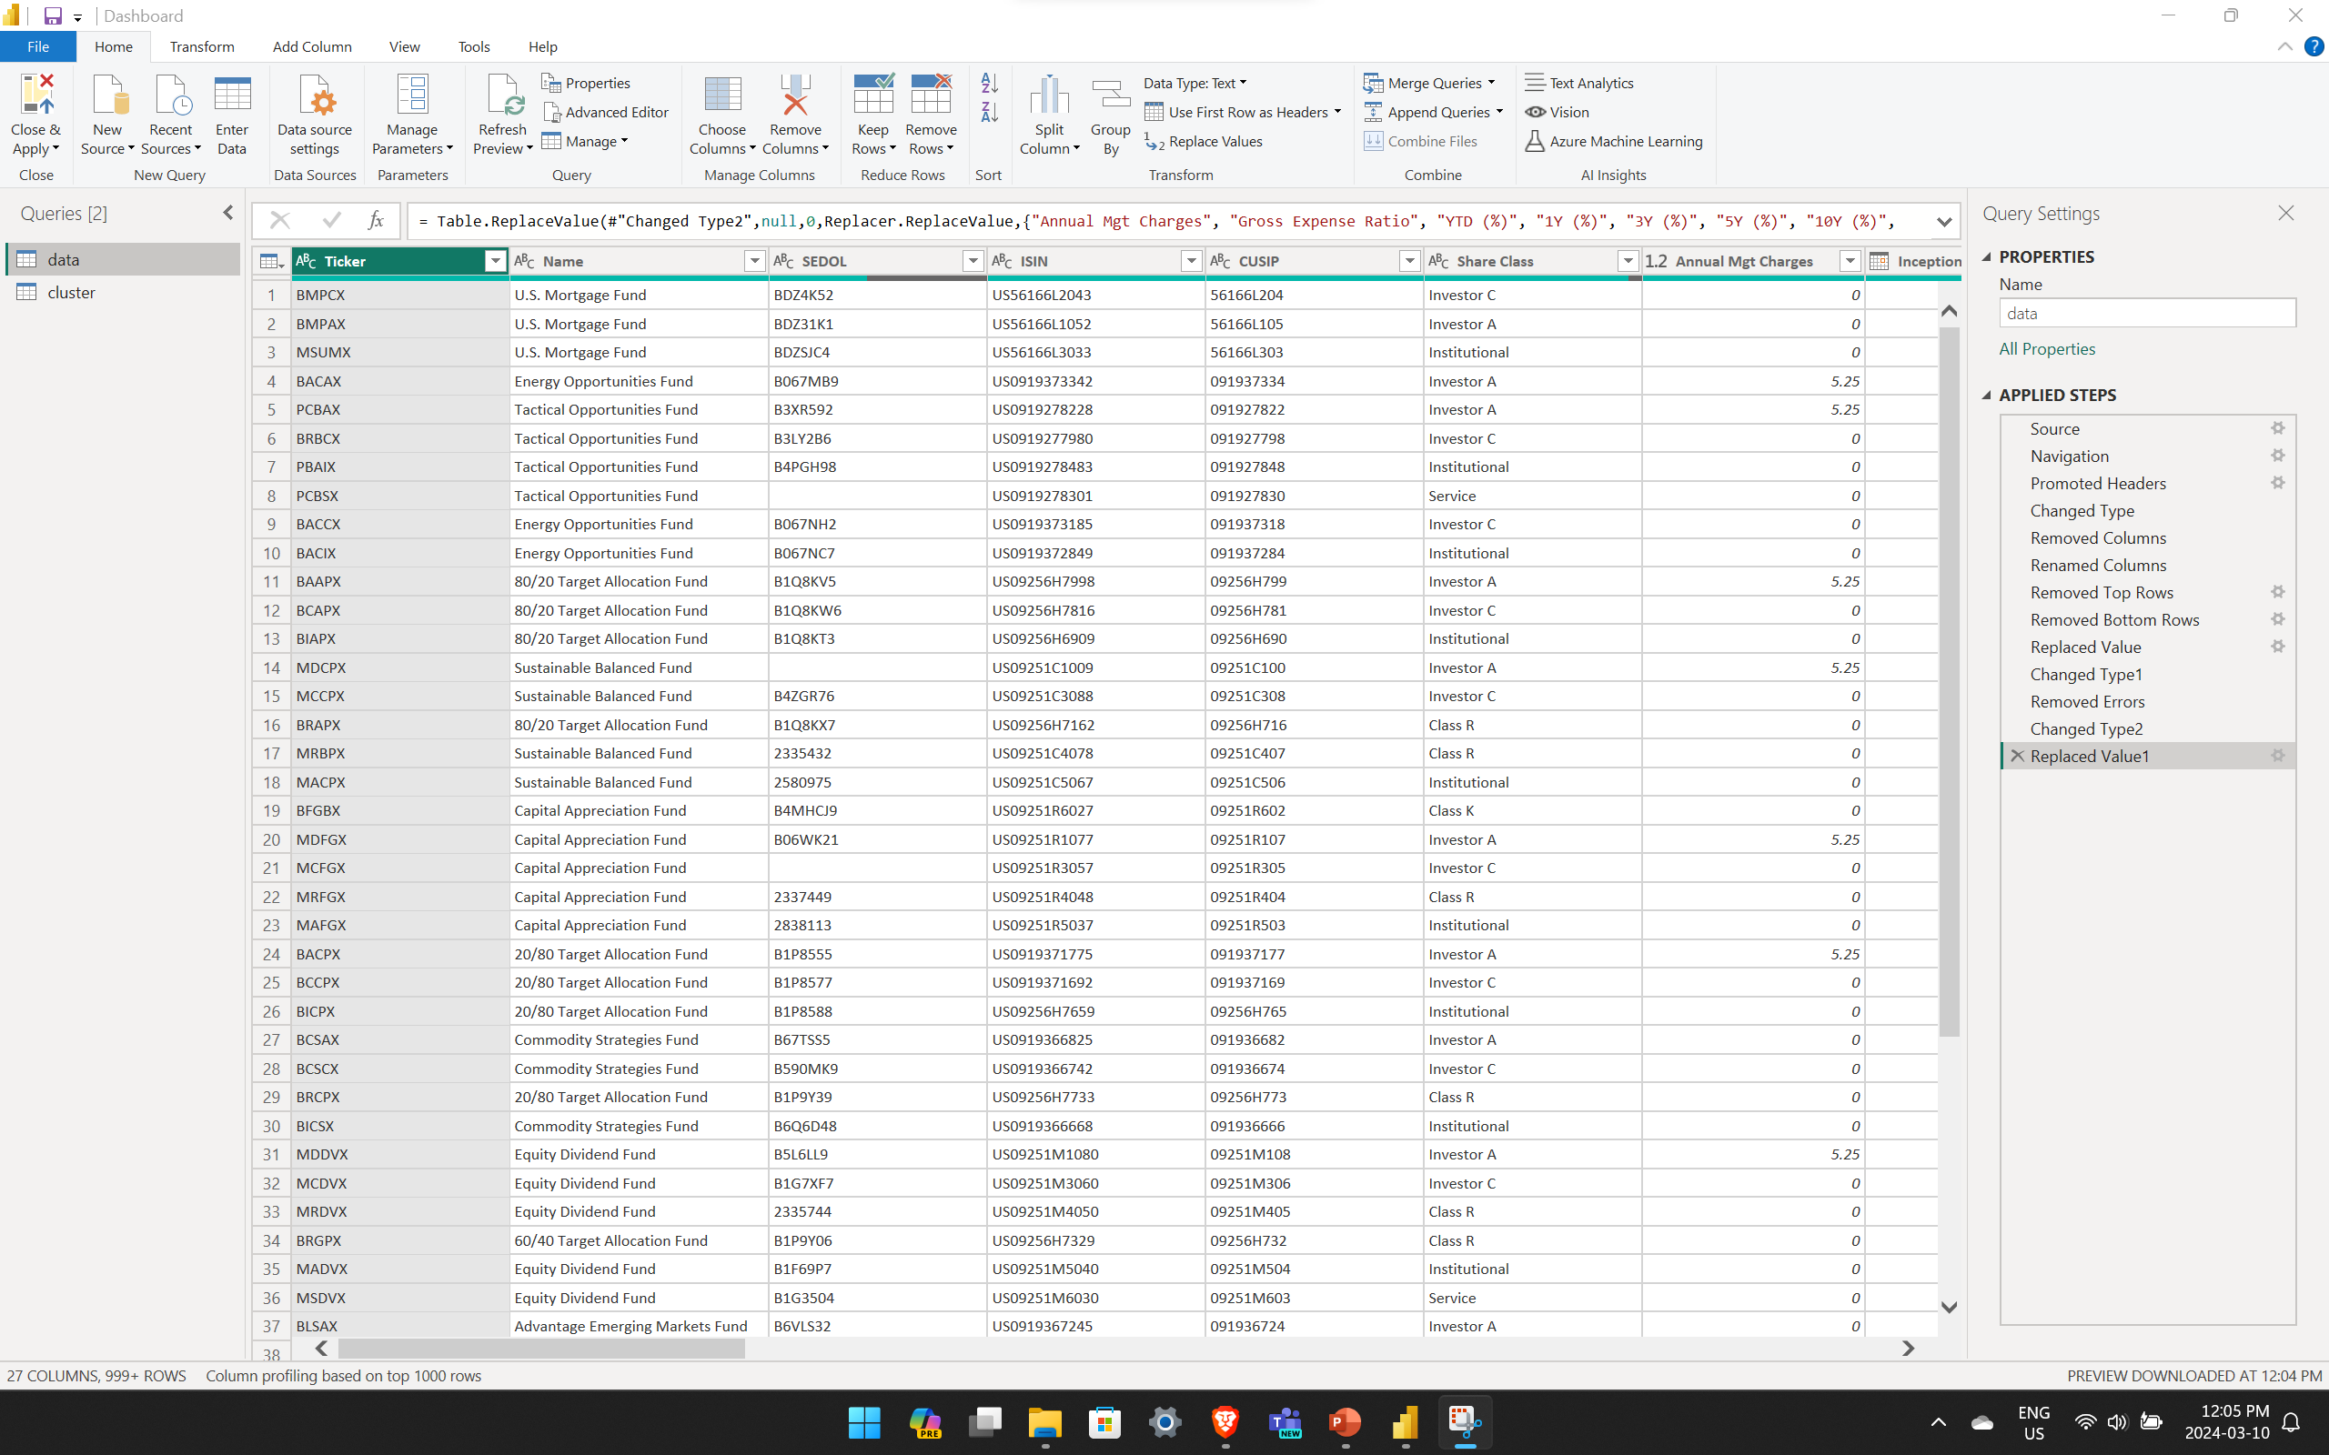
Screenshots of Activities

Slide 8
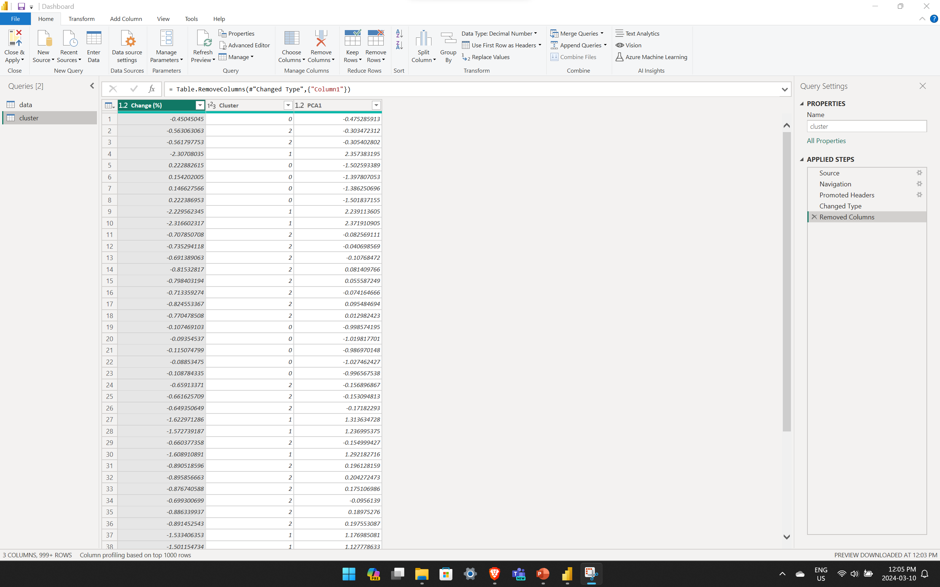
Screenshots of Activities

Slide 9



Communication
We had a phone conversation regarding the project progress and how we are going to proceed.

Slide 10

Activities to be completed before next week
Preparing the visualization and story.

Slide 11

Thank You Any Questions?

